Slide 1

BitBucket
Group-4

Slide 2
Members
Chaw Su Theint (4BIS – 32)
Mya Thet Cho (4BIS – 14)
Hnin Shwe Zin (4BIS-15)
Hsu Myat Noe Kyaw (4BIS - 36 )

Slide 3
What is configuration management?
a continuous process of recording and maintaining consistent and reliable records
an organization's hardware and software composition

Slide 4
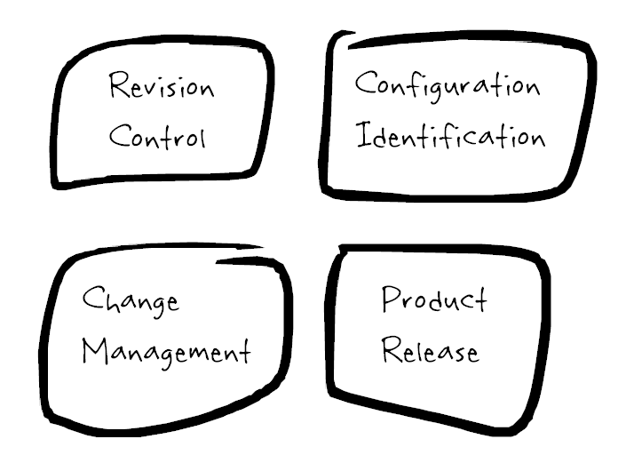

Slide 5
Why CM is important?
Enhanced system reliability through more rapid detection
Greater agility through more accurate analysis of the impact of potential changes to hardware, software, firmware, documentation, testing procedures
Improved performance
System compliance with established specifications and guidelines
Lowered probability of errors

Slide 6
What is Bitbucket?
web-based hosting service that is owned by Atlassian, used for source code and development projects
written in Python using the Django web framework.

Slide 7
Awesome reasons to use Bitbucket
Superior Code Review
JIRA integration
Built-in Issue Tracker
In-Line Discussions
Great Pricing
Great Interface
Unlimited Private Repositories
Import existing code

Slide 8
Thank you !!!

